Slide 1
IoT as enabler for monitoring/decreasing the carbon footprint of supply chains
Seminar Internet of Things & Security
Marc-Andre Juritz 05.05.2022

Slide 2
1. Motivation
Paris Agreement:
Preventing irreversible damage from man-made climate change
Upper limit of the CO2 budget that may still be emitted
Massive reduction of carbon emissions
Limitation of global warming to 1.5 degree
McKinsey (2016):
Consumer-packaged goods (CPG) companies are responsible for roughly 33 gigatons of CO2
Supply chain monitoring:
Many unknown parameters
Scope 3 emissions hard to measure
Short-term profit maximization is often seen as more important than long-term emissions reduction
BUT: No climate protection is more expensive in the long term than introducing appropriate measures to reduce emissions

Slide 3
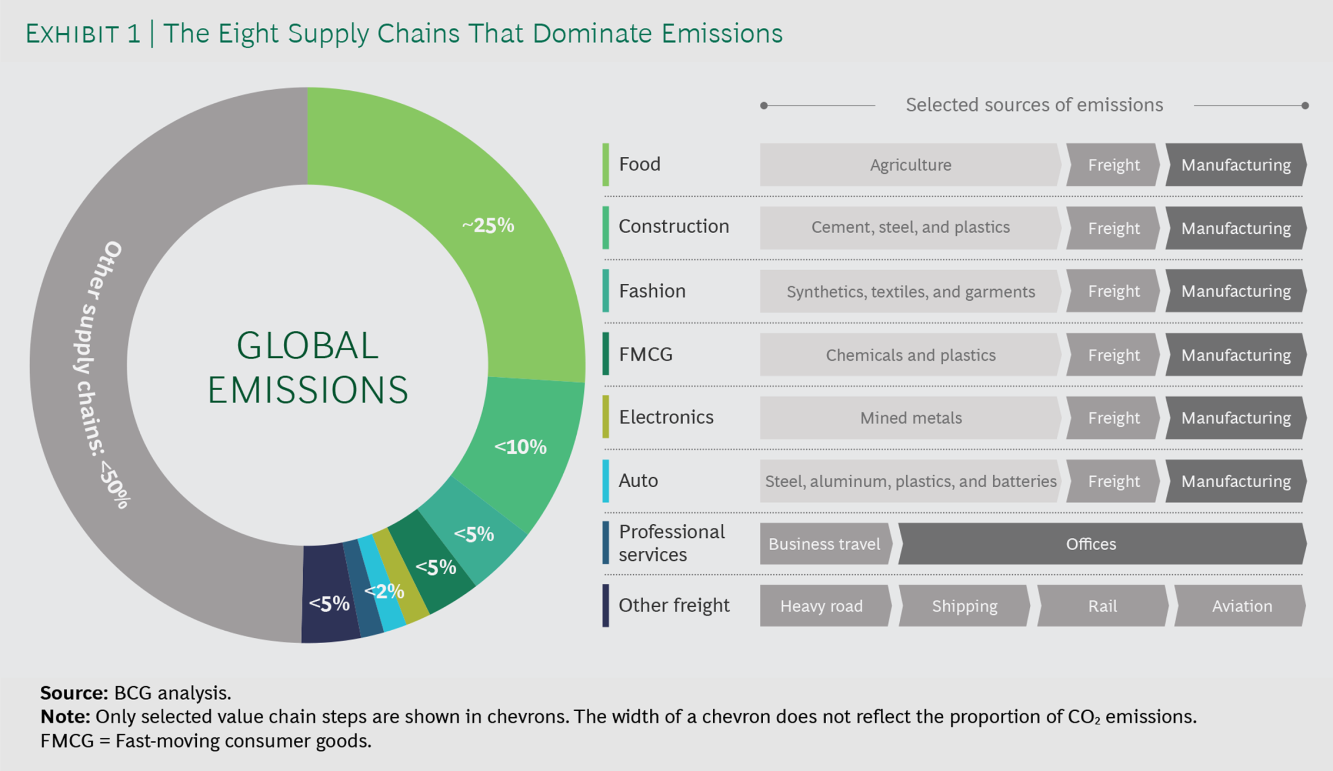

Slide 4
2. Paper structure
Introduction - Introduction to the domain - Problem definition - Outline of Contribution - Structure of the Paper
Preliminaries - Climate change - Supply Chain and carbon emissions - Green Supply Chain Management - Life Cycle Assessment (LCA) - IoT
Methodology - Literature research
IoT as enabler for sustainable supply chains - application fields of iot… - e.g. food supply chain
Detailed consideration of two solutions
IoT's own footprint - e-waste - energy consumption
Discussion - text - Open issues
Conclusion - Summary - Limitations
Notes:
Abhängigkeit des Nutzens der Features von dem Zeitpunkt/der Station innerhalb des Fast Track Verfahrens

Slide 5
3. List of references („width“ coverage)
Haass, Rasmus & Dittmer, Patrick & Veigt, Marius & Lütjen, Michael. (2014). Reducing food losses and carbon emission by using autonomous control – A simulation study of the intelligent container. International Journal of Production Economics. 164. 10.1016/j.ijpe.2014.12.013.
Ilic, Alexander & Staake, Thorsten & Fleisch, Elgar. (2009). Using Sensor Information to Reduce the Carbon Footprint of Perishable Goods. Pervasive Computing, IEEE. 8. 22 - 29. 10.1109/MPRV.2009.20.
He, Miao & Ren, Changrui & Wang, Qinhua & Shao, Bing & Dong, Jin. (2010). The Internet of Things as an Enabler to Supply Chain Innovation. 326 - 331. 10.1109/ICEBE.2010.11.
Varriale, Vincenzo & Cammarano, Antonello & Michelino, Francesca & Caputo, Mauro. (2021). Sustainable Supply Chains with Blockchain, IoT and RFID: A Simulation on Order Management. Sustainability. 13. 6372. 10.3390/su13116372.
Lafferty, C.. (2019). Sustainable internet-of-things-based manufacturing systems: Industry 4.0 wireless networks, advanced digitalization, and big data-driven smart production. Economics, Management, and Financial Markets. 14. 16-22. 10.22381/EMFM14420192.
Hu, Fangjie & Zhang, Xiaoqiang & Tian, Gang. (2012). Research on Low Carbon Logistics System Based on Internet of Things. 806-812. 10.1061/9780784412602.0125.
Pimsakul, S., Samaranayake, P., & Laosirihongthong, T. (2021). Prioritizing enabling factors of IoT adoption for sustainability in supply chain management. Sustainability, 13(22). https://doi.org/10.3390/su132212890
Jagtap, Sandeep & Garcia-Garcia, Guillermo & Rahimifard, Shahin. (2021). Optimisation of the resource efficiency of food manufacturing via the Internet of Things. Computers in Industry. 127. 10.1016/j.compind.2021.103397.

Slide 6
4. Focus on a particular solution („depth“ coverage)
Jagtap, Sandeep & Garcia-Garcia, Guillermo & Rahimifard, Shahin. (2021). Optimisation of the resource efficiency of food manufacturing via the Internet of Things. Computers in Industry. 127. 10.1016/j.compind.2021.103397.
Inefficient food supply chain, large amount of food waste,volumes of water and energy used
increasing economic costs
stricter regulations on the disposal and treatment of food waste, carbon emissions and wastewater
discharge
accurate real-time monitoring → help food manufacturers to redesign their processes
Paper presents: IoT-based framework for monitoring the generation of food waste and the use of energy and water in the food sector

Slide 7
5. Time schedule towards report submission
Today Midterm presentation
May 22nd Finish literature collection
June 5th Finish bullet point writing plan
June 8th Submit work-in-progress version of the report
June 26th Finish writing of paper
July 3rd Submit final version of the report
July 6th Final presentation session

